Slide 1
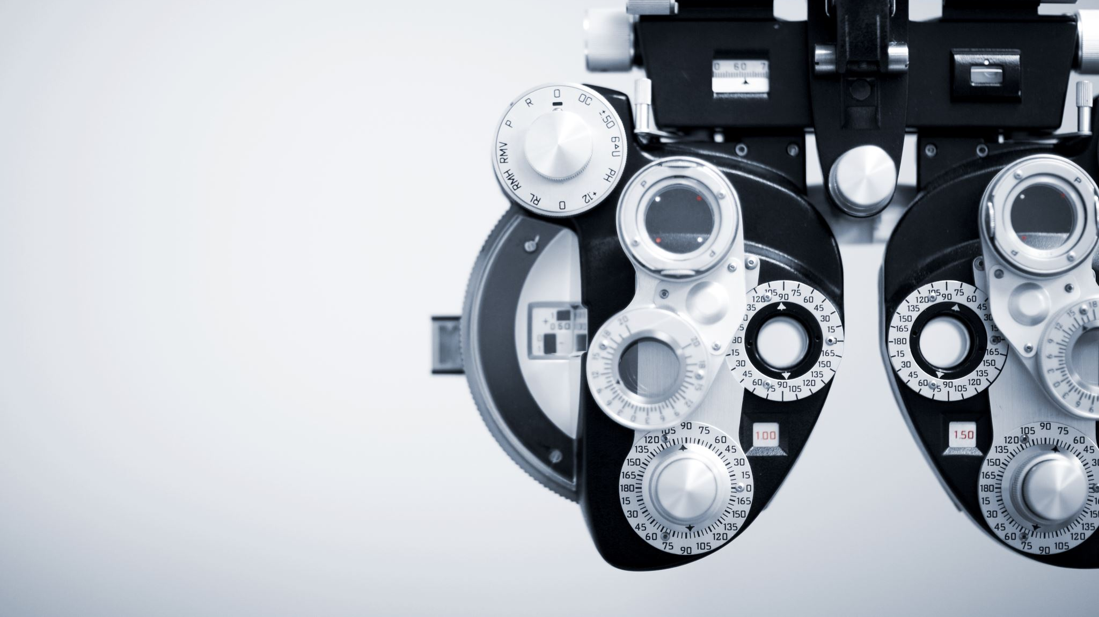
Dangerous Object Detection System
Real-time Detection and Reporting

Slide 2
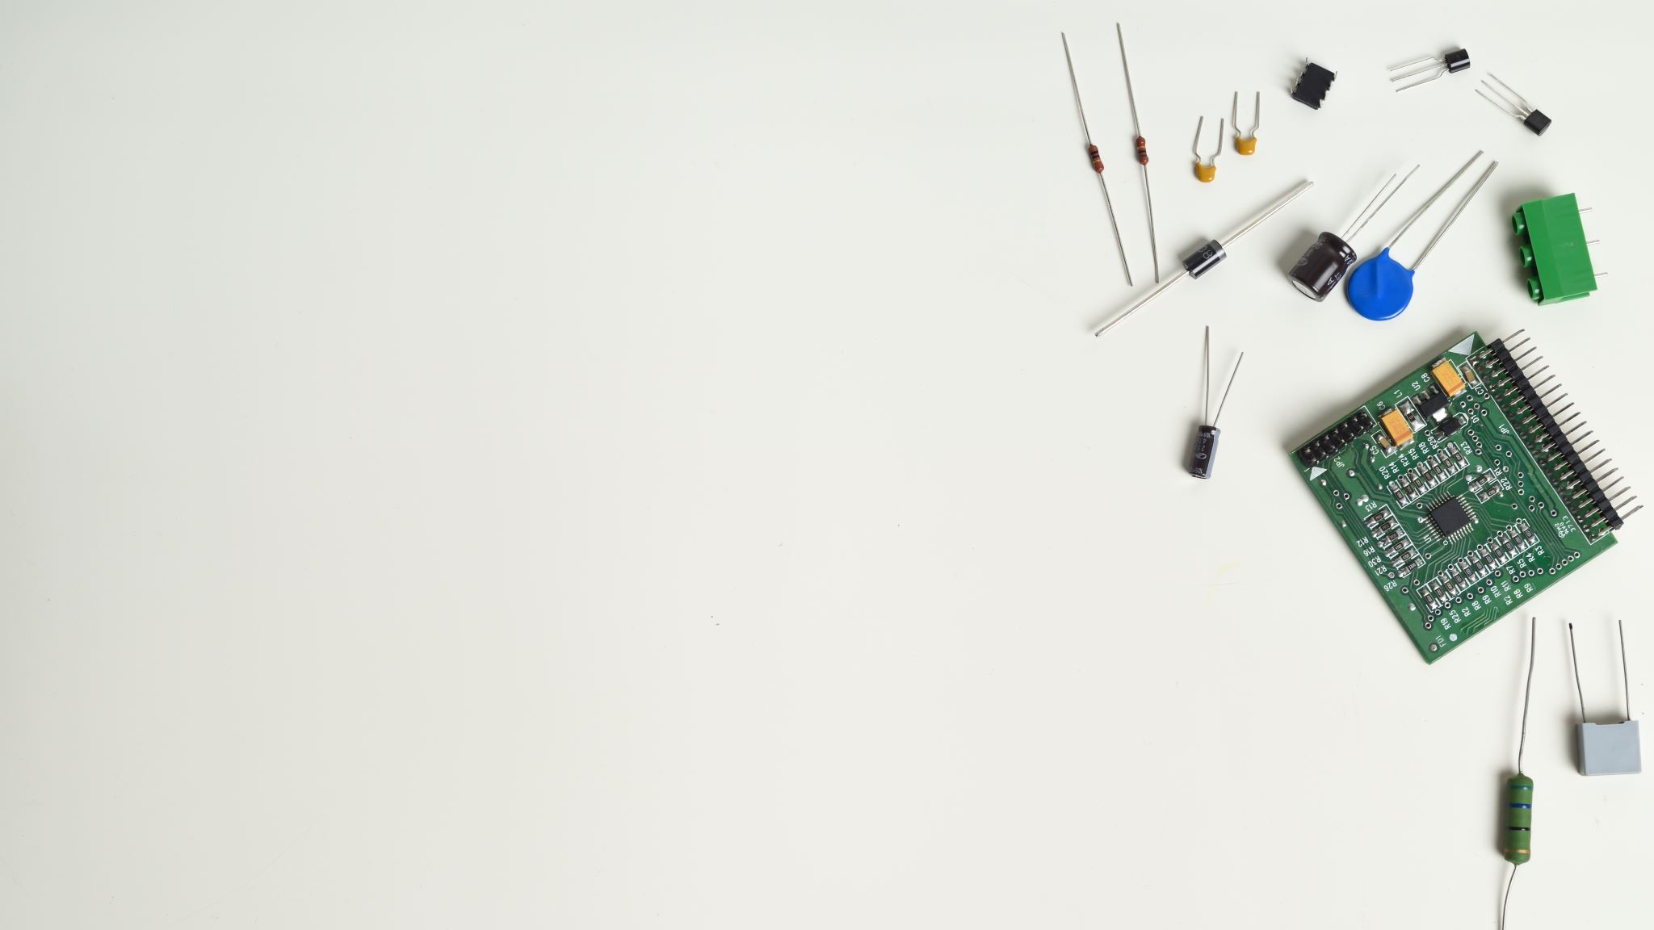
Group Members
Manarth Patel – 100943851
Raskshay Patel- 100954533
Shriram Yadav- 100951170
Miraj Sutariya- 100953042
Manu Shrivastava – 100954026

Slide 3

Introduction
Goal: Use machine learning to create a system that detects risky objects in real time.
Issue: Rapid and precise hazard identification is required in places where safety is paramount.

Slide 4

System Architecture
Software
Input: Camera Feed
Backend: FastAPI Server
Object Detection Model: Pre-trained Model(We use customized data to train model)
Frontend: Streamlit Application
Deployment: Local/Cloud Server
Hardware
NVIDIA RTX 4090

Slide 5
Key Features
Real-time Detection: Identifies hazardous objects from live feed
PDF Report: Saves detected objects with timestamps
User Interface: Streamlit for ease of use
Continuous Monitoring: Runs until manually stopped

Slide 6
Conclusion
The Dangerous Object Detection System efficiently provides real-time hazard detection with an intuitive interface built on FastAPI and Streamlit. It ensures accurate monitoring and reporting, with potential for future enhancements to broaden its applications.

